Slide 1
Title of Poster Subtitle
PRESENTER: Name
INTRO
Explain why your study matters in the fastest, most brutal way possible (feel free to add graphics!).
METHODS
How did you find this?
Collected [what] from [population]
How you tested it.
Illustrate your methods if you can!
RESULTS
Graph/table with essential results only.
All the other correlations go into the far right column.
OPTIONAL
TOP ICON;
SEE PAGE 5
DELETE IF UNUSED
Delete this and replace it with your…
Extra Graphs
Extra Correlation tables
Extra Figures
Extra nuance that you’re worried about leaving out.
Keep it messy! This section is just for you.
author1, author2, author3, author4, author5, author6, author7, author42
State your main finding here in plain English as a single sentence.
Delete this and add an image, graphic, or a key figure.
DELETE & REPLACE WITH YOUR OWN QR CODE
Take a picture to download the full paper
Delete and replace with your own department or college label
https://brand.fiu.edu/downloads/

Slide 2
Title of Poster Subtitle
PRESENTER: Name
INTRO
Explain why your study matters in the fastest, most brutal way possible (feel free to add graphics!).
METHODS
How did you find this?
Collected [what] from [population]
How you tested it.
Illustrate your methods if you can!
RESULTS
Graph/table with essential results only.
All the other correlations go into the far right column.
OPTIONAL
TOP ICON;
SEE PAGE 5
DELETE IF UNUSED
Delete this and replace it with your…
Extra Graphs
Extra Correlation tables
Extra Figures
Extra nuance that you’re worried about leaving out.
Keep it messy! This section is just for you.
author1, author2, author3, author4, author5, author6, author7, author42
State your main finding here in plain English as a single sentence.
Delete this and add an image, graphic, or a key figure.
DELETE & REPLACE WITH YOUR OWN QR CODE
Take a picture to download the full paper
Delete and replace with your own department or college label
https://brand.fiu.edu/downloads/

Slide 3
Title of Poster Subtitle
PRESENTER: Name
INTRO
Explain why your study matters in the fastest, most brutal way possible (feel free to add graphics!).
METHODS
How did you find this?
Collected [what] from [population]
How you tested it.
Illustrate your methods if you can!
RESULTS
Graph/table with essential results only.
All the other correlations go into the far right column.
OPTIONAL
TOP ICON;
SEE PAGE 5
DELETE IF UNUSED
Delete this and replace it with your…
Extra Graphs
Extra Correlation tables
Extra Figures
Extra nuance that you’re worried about leaving out.
Keep it messy! This section is just for you.
author1, author2, author3, author4, author5, author6, author7, author42
State your main finding here in plain English as a single sentence.
Delete this and add an image, graphic, or a key figure.
DELETE & REPLACE WITH YOUR OWN QR CODE
Take a picture to download the full paper
Delete and replace with your own department or college label
https://brand.fiu.edu/downloads/

Slide 4
Title of Poster Subtitle
PRESENTER: Name
INTRO
Explain why your study matters in the fastest, most brutal way possible (feel free to add graphics!).
METHODS
How did you find this?
Collected [what] from [population]
How you tested it.
Illustrate your methods if you can!
RESULTS
Graph/table with essential results only.
All the other correlations go into the far right column.
OPTIONAL
TOP ICON;
SEE PAGE 5
DELETE IF UNUSED
Delete this and replace it with your…
Extra Graphs
Extra Correlation tables
Extra Figures
Extra nuance that you’re worried about leaving out.
Keep it messy! This section is just for you.
author1, author2, author3, author4, author5, author6, author7, author42
State your main finding here in plain English as a single sentence.
Delete this and add an image, graphic, or a key figure.
DELETE & REPLACE WITH YOUR OWN QR CODE
Take a picture to download the full paper
Delete and replace with your own department or college label
https://brand.fiu.edu/downloads/

Slide 5
Title of Poster Subtitle
PRESENTER: Name
INTRO
Explain why your study matters in the fastest, most brutal way possible (feel free to add graphics!).
METHODS
How did you find this?
Collected [what] from [population]
How you tested it.
Illustrate your methods if you can!
RESULTS
Graph/table with essential results only.
All the other correlations go into the far right column.
OPTIONAL
TOP ICON;
SEE PAGE 5
DELETE IF UNUSED
Delete this and replace it with your…
Extra Graphs
Extra Correlation tables
Extra Figures
Extra nuance that you’re worried about leaving out.
Keep it messy! This section is just for you.
author1, author2, author3, author4, author5, author6, author7, author42
State your main finding here in plain English as a single sentence.
Delete this and add an image, graphic, or a key figure.
DELETE & REPLACE WITH YOUR OWN QR CODE
Take a picture to download the full paper
Delete and replace with your own department or college label
https://brand.fiu.edu/downloads/

Slide 6
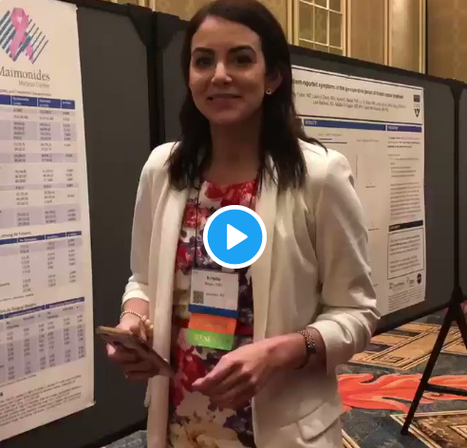
How to QR Code
How do I create a QR code?
https://www.qrcode-monkey.com/ is free, URLs don’t expire, and you can add cool features like images.
How do I scan a QR code?
Just pull out your phone and take a picture! All modern iPhones and most Android phones have built-in QR detection in their cameras. Some Android phones may need an app.
How can I link the QR to my paper and a copy of my poster and my contact details.
Try creating a multi-page link for free via https://linktr.ee/.
Ctrl-click this thumbnail to watch a video on scanning #betterposter QR codes.
Donated by @kristinrojasmd
https://twitter.com/kristinrojasmd/status/1124418213050298368

Slide 7
Layout
Objective: Capture people’s interest quickly at a poster session.
What if my intro/methods/results doesn’t fit in the far left column?
If you’re trying to put so much into that space that it doesn’t fit, viewers won’t have time to read it anyway. First try moving stuff to the right column. Next, cut cut cut.
Instead of trying to fill space, you’re trying to conserve space.
What if I have a really important graph or picture?
Move the QR Code to the left column, then put your graph/image in the middle.
When it looks too simple to represent the amount of time you put into it, you’re done.

Slide 8
What research influenced this idea?
1. Need To Know > Nice To Know
https://www.nngroup.com/articles/inverted-pyramid
2. Plain language is interpreted faster
https://www.nngroup.com/videos/plain-language-for-experts/
https://www.nngroup.com/articles/plain-language-experts/
3. Interaction cost
https://www.nngroup.com/articles/interaction-cost-definition/
4. The notion of “cognitive load” in UX design
https://www.nngroup.com/articles/minimize-cognitive-load/

