Slide 1
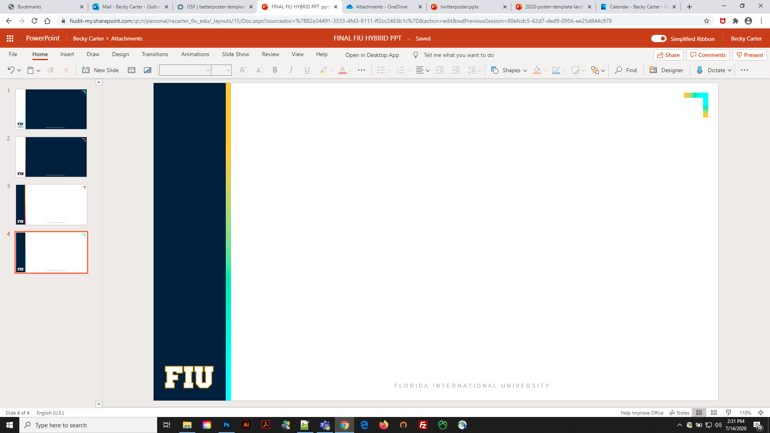

Full Poster Title Here
Your name here
Your email here
Your institution, college, employer, sponsor, parents, pet, or guru
Add any required citations or partner affiliations
Basically, all the fine print goes in this column
State your main finding in plain English and a single sentence.
Place an important figure in this large block, and your footnotes here.
Place a comparison figure in this large block, and your footnotes here.
DELETE & REPLACE WITH YOUR OWN QR CODE
Highlights
Your paper highlights should go here.
Highlights should be short and easy for a viewer to read.
Include any invitations for further study or collaboration.
Recommended maximum word count for this section = 60
Summary
Recommended maximum word count for this section = 80
Methods
Recommended maximum word count for this section = 80
Delete and replace with your department or college label
https://brand.fiu.edu/downloads/

Slide 2
Full Poster Title Here
Your name here
Your email here
Your institution, college, employer, sponsor, parents, pet, or guru
Add any required citations or partner affiliations
Basically, all the fine print goes in this column
State your main finding in plain English and a single sentence.
Place an important figure in this large block, and your footnotes here.
Place a comparison figure in this large block, and your footnotes here.
DELETE & REPLACE WITH YOUR OWN QR CODE
Highlights
Your paper highlights should go here.
Highlights should be short and easy for a viewer to read.
Include any invitations for further study or collaboration.
Recommended maximum word count for this section = 60
Summary
Recommended maximum word count for this section = 80
Methods
Recommended maximum word count for this section = 80
Delete and replace with your department or college label
https://brand.fiu.edu/downloads/

Slide 3
Full Poster Title Here
Your name here
Your email here
Your institution, college, employer, sponsor, parents, pet, or guru
Add any required citations or partner affiliations
Basically, all the fine print goes in this column
State your main finding in plain English and a single sentence.
Place an important figure in this large block, and your footnotes here.
Place a comparison figure in this large block, and your footnotes here.
DELETE & REPLACE WITH YOUR OWN QR CODE
Highlights
Your paper highlights should go here.
Highlights should be short and easy for a viewer to read.
Include any invitations for further study or collaboration.
Recommended maximum word count for this section = 60
Summary
Recommended maximum word count for this section = 80
Methods
Recommended maximum word count for this section = 80
Delete and replace with your department or college label
https://brand.fiu.edu/downloads/

Slide 4
Layout
Objective: Capture people’s interest quickly at a poster session.
What if my intro/methods/results doesn’t fit in the assigned space?
If you’re trying to put so much into that space that it doesn’t fit, viewers won’t have time to read it anyway. First try moving stuff to the right column. Next, cut cut CUT.
Instead of trying to fill space, you’re trying to conserve space.
When it looks too simple to represent the amount of time you put into it, you’re done.

Slide 5

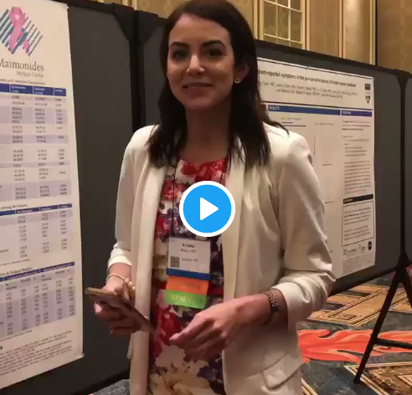

How To QR Code
How do I create a QR code?
https://www.qrcode-monkey.com/ is free, URLs don’t expire, and you can add cool features like images.
How do I scan a QR code?
Just pull out your phone and take a picture! All modern iPhones and most Android phones have built-in QR detection in their cameras. Some Android phones may need an app.
How can I link the QR to my paper and a copy of my poster and my contact details.
Try creating a multi-page link for free via https://linktr.ee/. (Still trying to figure out the best answer to this though.
Ctrl-click this thumbnail to watch a video on scanning #betterposter QR codes.
Donated by @kristinrojasmd
https://twitter.com/kristinrojasmd/status/1124418213050298368

Slide 6
What research influenced this idea?
1. Need To Know > Nice To Know
https://www.nngroup.com/articles/inverted-pyramid
2. Plain language is interpreted faster
https://www.nngroup.com/videos/plain-language-for-experts/
https://www.nngroup.com/articles/plain-language-experts/
3. Interaction cost
https://www.nngroup.com/articles/interaction-cost-definition/
4. The notion of “cognitive load” in UX design
https://www.nngroup.com/articles/minimize-cognitive-load/

