Slide 1

State your main takeaway on the first slide.
Include relevant imagery, too
Search here > thenounproject.com

Slide 2
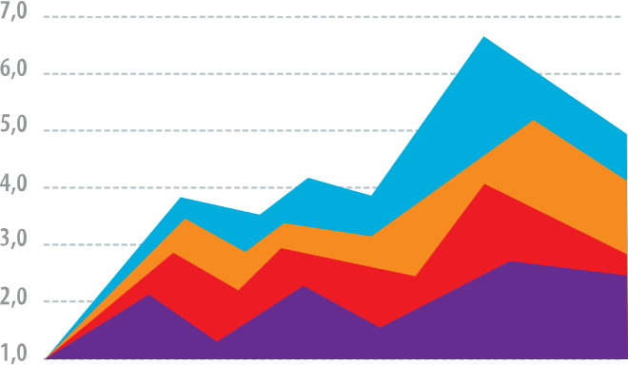
Add a single key figure and explain what it shows.

Slide 3
(Give your viewers a couple slides to process figures; this duplication is important for timing in a later step.)

Slide 4
Explain why your finding matters in plain English.

Slide 5
Teach your methods in steps
1
Initial state
Transformation

Slide 6
Teach your methods in steps
1
2
Initial state
Transformation
Results

Slide 7

Your Name
Affiliation or Department
@YourTwitterHandle

Slide 8
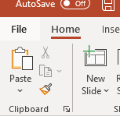
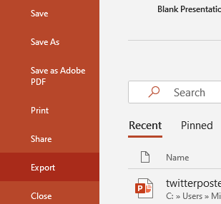
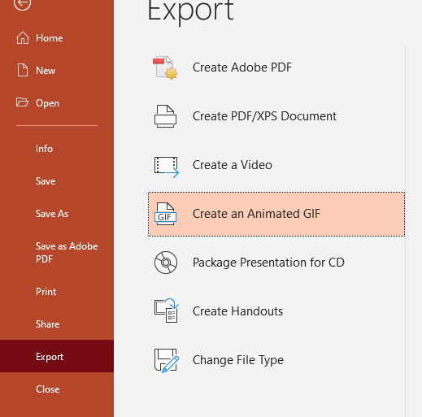
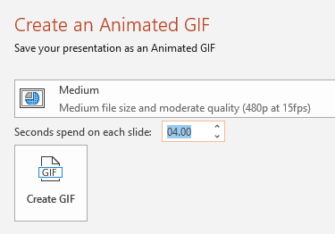
All done? Delete this slide and save as an animated GIF:
1. File
2. Export
3. Create Animated GIF
4. Set Quality to Medium and Seconds to ~4-5
5. Create GIF and save the file to your computer
6. Share on Twitter!

